Slide 1

Text-to-Music Generation with Emotional Nuance: Multi-dimensional Emotion Space Modeling
By: Josephine, Malina, Wasif
Team name: Resona

Slide 2
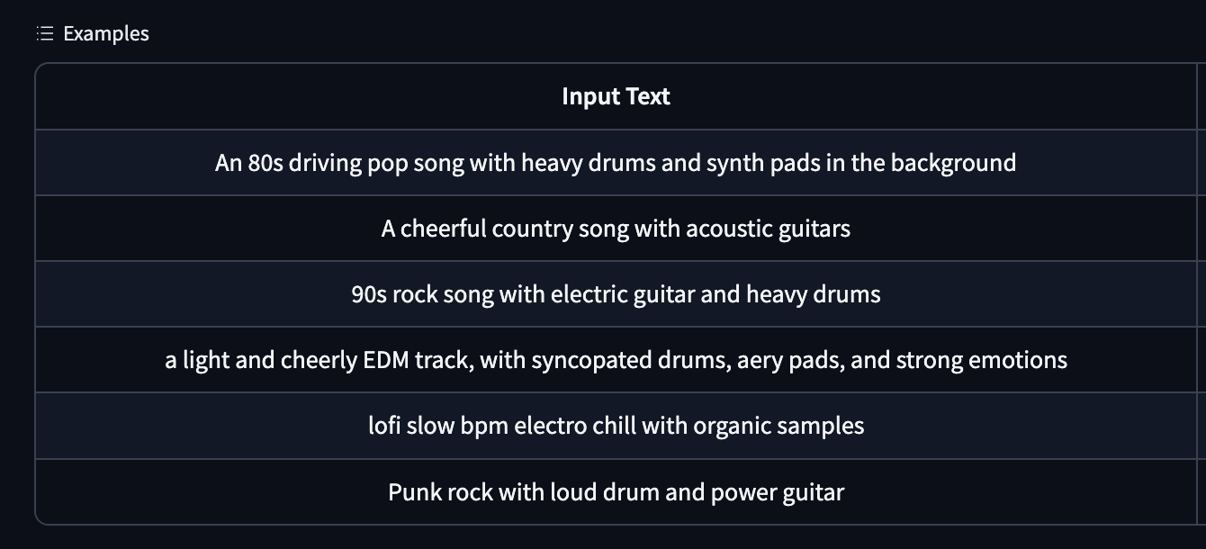
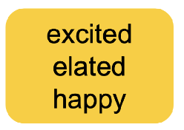

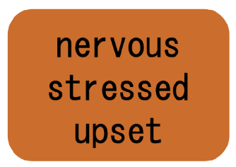
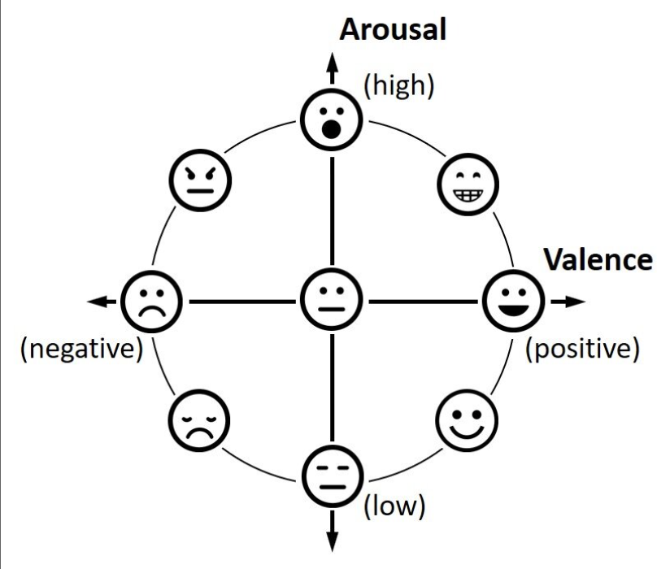
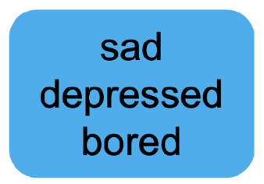
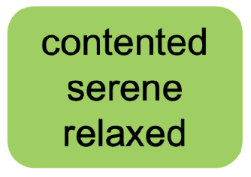
Background & Research Hypothesis
Problem: "sad but hopeful" versus "purely tragic" ?
Hypothesize: VA-based emotion conditioning will enable music generation models to generate musically distinct, nuanced emotional outputs.
Russell's Circumplex Model of Affect (VA model)
Mahmood, Mahmood A., et al. "Segmentation-enhanced approach for emotion detection from EEG signals using the fuzzy C-mean and SVM." Scientific Reports 15.1 (2025): 31956.
Text-to-Music Generation with Emotional Nuance
Resona
Notes:
Current text-to-music AI models, like MusicGen, often struggle with subtle emotional nuances, failing to distinguish between feelings such as "sad but hopeful" versus "purely tragic." Our project aims to solve this by conditioning the AI on Russell's Circumplex Model of Affect, which maps emotions onto a multidimensional space of valence (pleasantness), arousal (intensity), and dominance. We hypothesize that training MusicGen with this numerical, Valence-Arousal(VA) based emotion conditioning will enable it to generate musically distinct outputs for nuanced emotional descriptions, outperforming models that rely solely on text prompts.

Slide 3




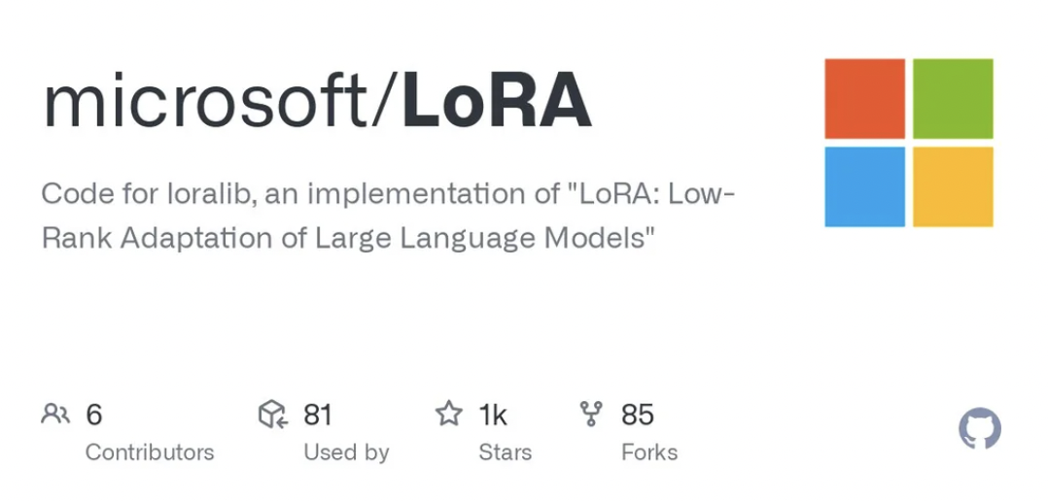

Methodology & Tools
Summarize the analytical approaches and tools used during the Academy, and explain how they will be extended or refined.
Step 4:
Evaluation
Step 5:Optimization
Step 1:Data Collection
Step 2:Emotion Conditioning
Step 3:Model Fine-tuning
Compile a standardized VA dataset
Emotion Encoder
Modified Cross-Attention
Leveraging Low-Rank Decomposition (LoRA) method
Interactive Demo
Human-in-the-Loop Evaluation: A/B Testing & VA-Value Rating
Refine the model based on the feedback gathered from the evaluations
Pre trained model: MusicGen
Text-to-Music Generation with Emotional Nuance
Resona
Notes:
Our goal is to make MusicGen generate music that expresses emotions, not just sounds. We use the Valence–Arousal framework to represent emotions along two dimensions: pleasantness and intensity.
First, we standardize several datasets, like MusicCaps, into this common VA format. Then, we map these VA values into MusicGen’s embedding space and combine them with text prompts through cross-attention, so the model can consider both what we say and the emotion we want.
We fine-tune the model efficiently using LoRA, which adapts MusicGen without retraining everything from scratch. To evaluate, we built an interactive demo and conduct human-in-the-loop tests: A/B comparisons and VA ratings to see if the music reflects the intended emotions.
All of this runs with PyTorch, Hugging Face, LoRA, and Gradio on cloud platforms like ISP, Colab, and Kaggle

Slide 4
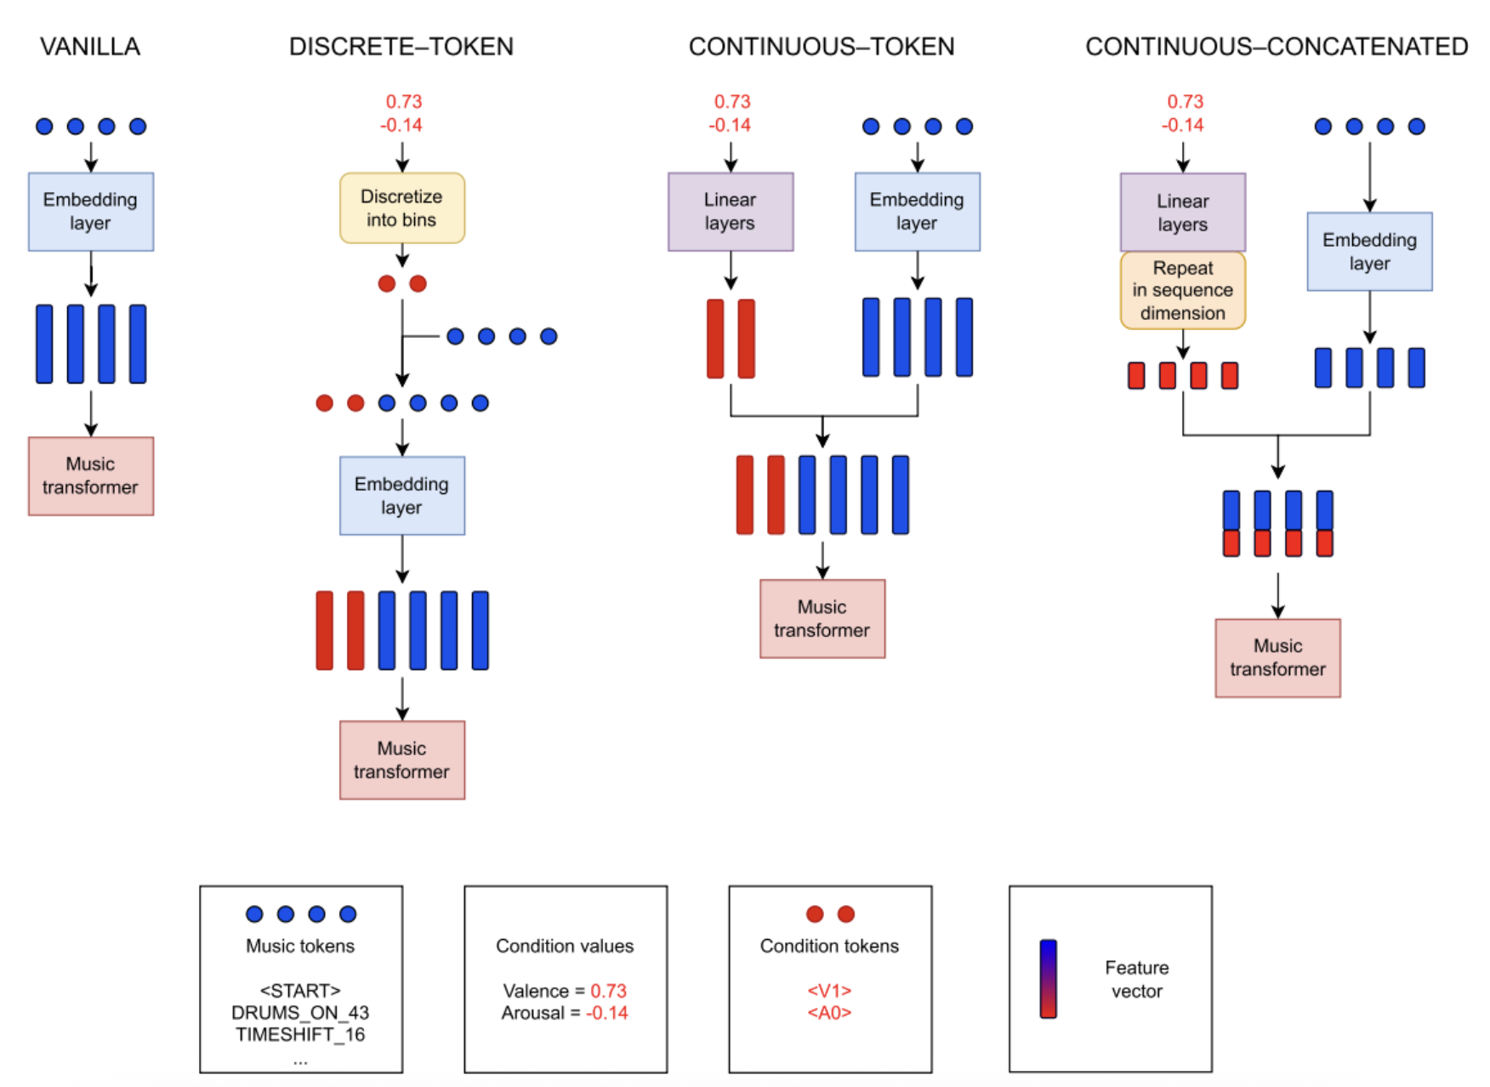
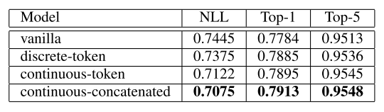
Preliminary Results
Four Architectures for Emotion Conditioning in Music Transformers
Model performance comparison
NLL (Negative Log-Likelihood): Error metric
lower value means better.
Top-1 and Top-5 Accuracy: Accuracy metrics higher value means better.
S. Sulun et al. Symbolic music generation conditioned on continuous-valued emotions. IEEE Access, 10:44617–44626, 2022.
Text-to-Music Generation with Emotional Nuance
Resona
Notes:
For preliminary results, as shown in the figure, a paper we reviewed successfully demonstrates how to embed a VA emotion model into a music transformer. It explored four distinct architectures, moving from discrete tokens to continuous-concatenated tokens.By comparing these approaches, the paper reveals that the continuous-concatenated architecture outperforms the others, achieving the lowest error (NLL) and highest accuracy, which indicates a superior ability to convey the intended emotion.

Slide 5
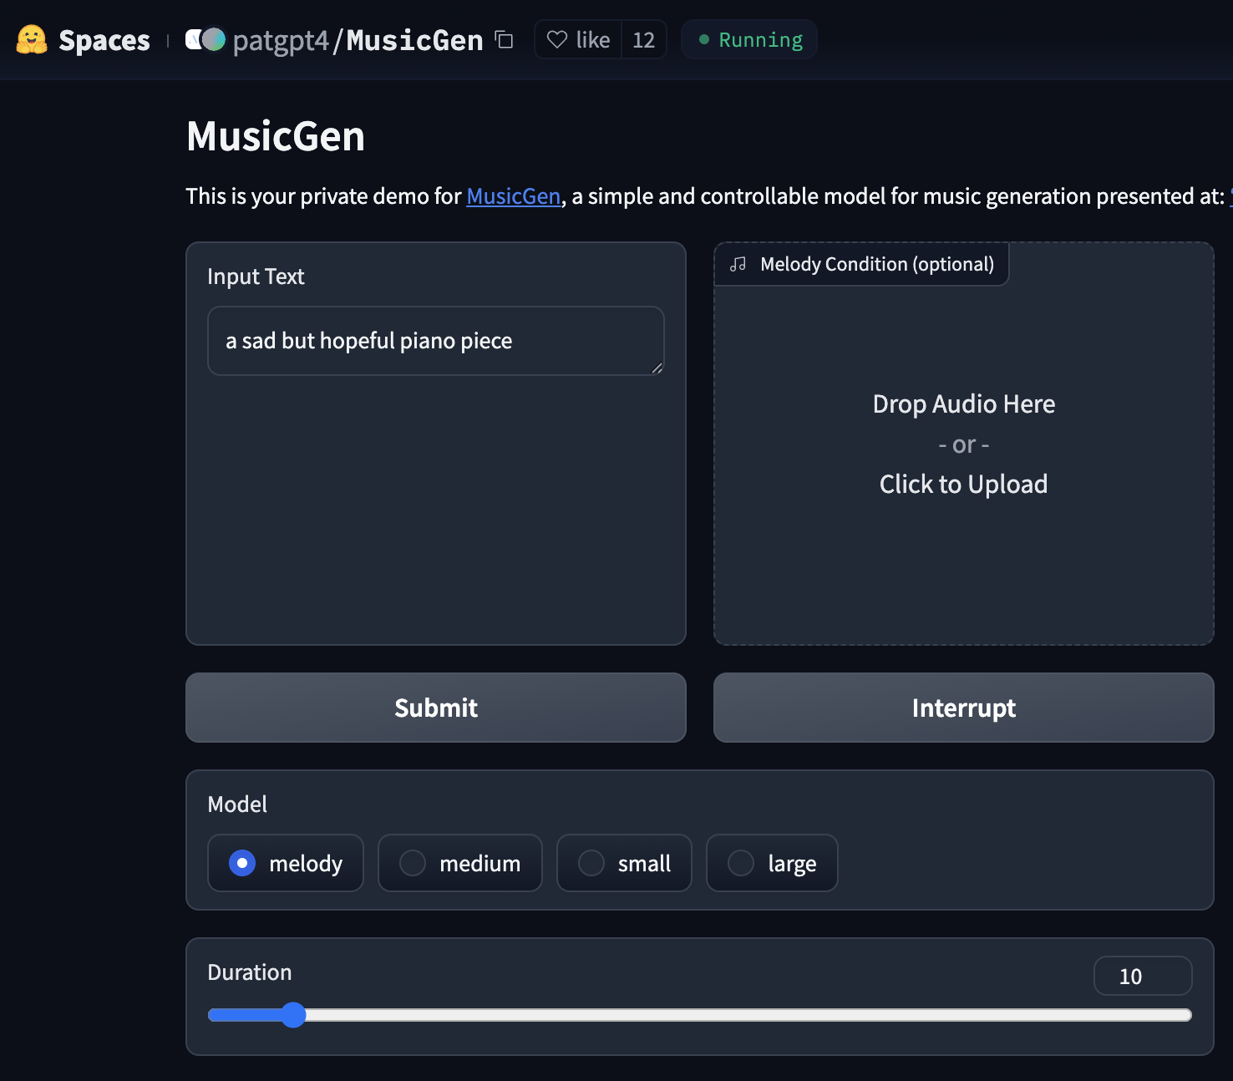
Potential Impact & Outcomes
Goals: Introduces fine-grained, psychologically grounded emotion modeling into music generation.
Contributions: A VA-conditioned text-to-music framework enabling finer emotional control.
Deliverables: Micropublication, open-source code, interactive demo.
Impact: Advances emotion-aware AI music generation for potential applications of personalized media, therapy, and creative tools.
Text-to-Music Generation with Emotional Nuance
Resona
Notes:
For this project, our goal is to developing a VA-conditioned text-to-music framework that enables finer emotional control. Our deliverables will include a micropublication, open-source code, and an interactive demo. We believe this will advance emotion-aware AI music generation, offering potential application in personalized media, music therapy, and creative tools.

Slide 6
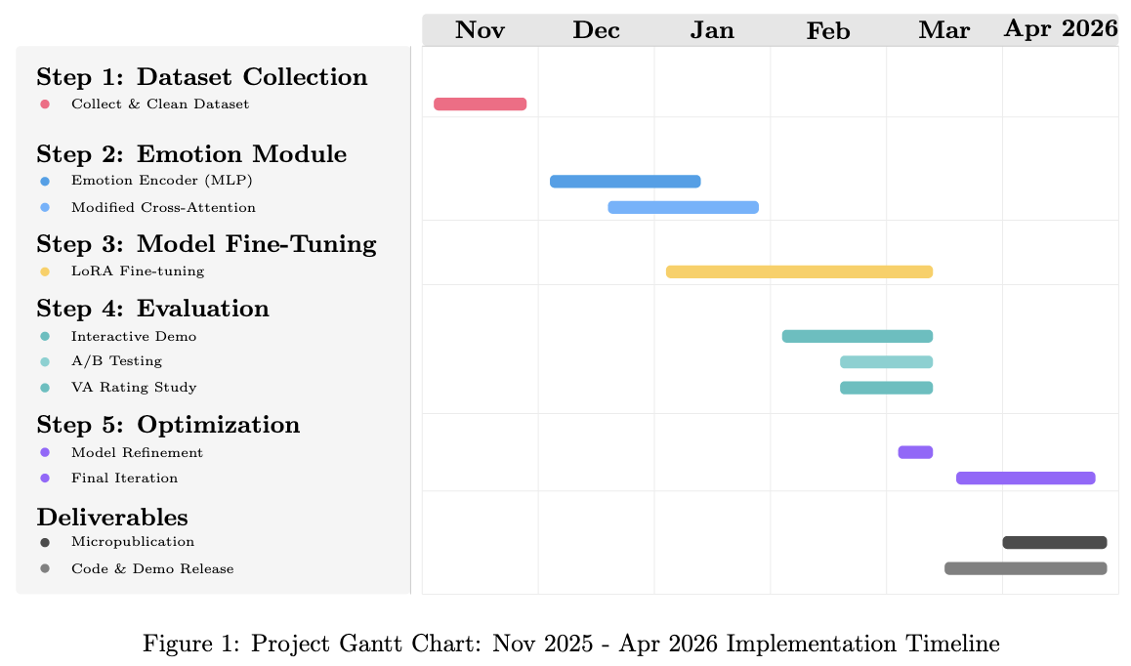
Work Plan & Timeline
Text-to-Music Generation with Emotional Nuance
Resona
Notes:
We anticipate dedicating the first month to collecting and cleaning the dataset. Fine-tuning the model is expected to be the most time-consuming phase, and our ultimate goal is to prepare our findings for micropublication.

